Slide 1
C++ Programming:
From Problem Analysis to Program Design, Fourth Edition
Chapter 8: User-Defined Simple Data Types, Namespaces, and the string Type

Slide 2
Objectives
In this chapter, you will:
Learn how to create and manipulate your own simple data type—called the enumeration type
Become familiar with the typedef statement
Learn about the namespace mechanism
Explore the string data type, and learn how to use the various string functions to manipulate strings
C++ Programming: From Problem Analysis to Program Design, Fourth Edition

Slide 3
Enumeration Type
Data type: a set of values together with a set of operations on those values
To define a new simple data type, called enumeration type, we need three things:
  A name for the data type
  A set of values for the data type
  A set of operations on the values
C++ Programming: From Problem Analysis to Program Design, Fourth Edition

Slide 4

Enumeration Type (continued)
A new simple data type can be defined by specifying its name and the values, but not the operations
  The values must be identifiers
Syntax:
  value1, value2, … are identifiers called enumerators
  value1 < value2 < value3 <...
C++ Programming: From Problem Analysis to Program Design, Fourth Edition

Slide 5
Enumeration Type (continued)
Enumeration type is an ordered set of values
If a value has been used in one enumeration type it can’t be used by another in same block
The same rules apply to enumeration types declared outside of any blocks
C++ Programming: From Problem Analysis to Program Design, Fourth Edition

Slide 6
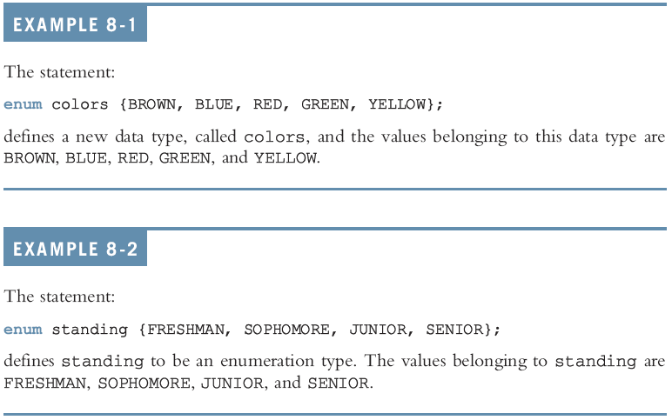
Enumeration Type (continued)
C++ Programming: From Problem Analysis to Program Design, Fourth Edition

Slide 7
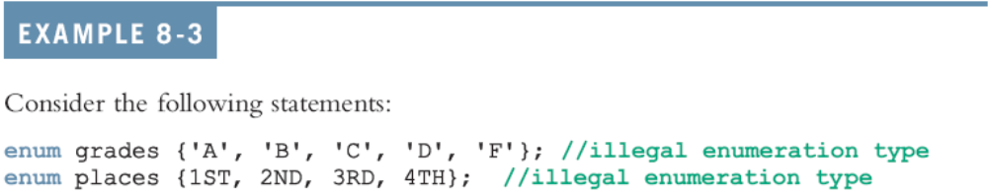
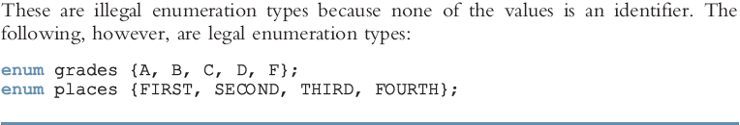
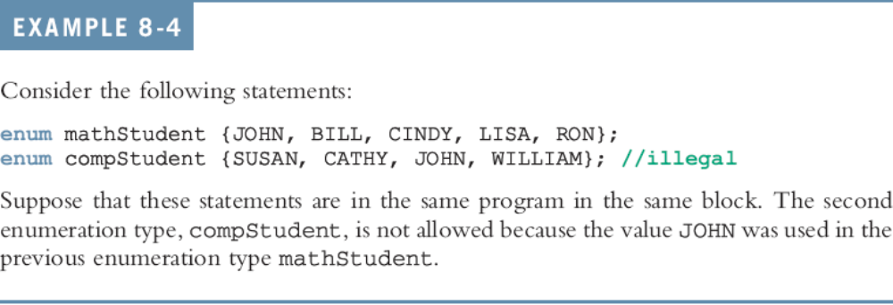

Slide 8

Declaring Variables
Syntax:
For example, given the following definition:
we can declare the following variables:
C++ Programming: From Problem Analysis to Program Design, Fourth Edition

Slide 9
Assignment
The statement:
popularSport = FOOTBALL;
stores FOOTBALL into popularSport
The statement:
mySport = popularSport;
copies the value of the popularSport into mySport
C++ Programming: From Problem Analysis to Program Design, Fourth Edition

Slide 10
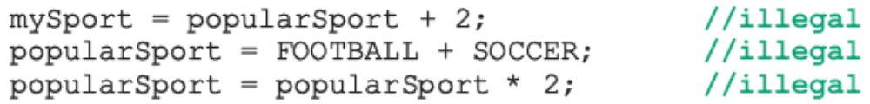
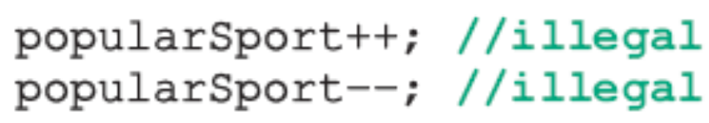
Operations on Enumeration Types
No arithmetic operations are allowed on enumeration types
++ and -- are illegal too:
Solution: use a static cast:
C++ Programming: From Problem Analysis to Program Design, Fourth Edition

Slide 11
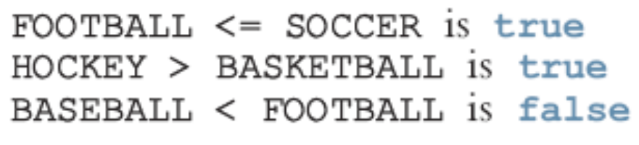
Relational Operators
An enumeration type is an ordered set of values:
Enumeration type is an integer data type and can be used in loops:
C++ Programming: From Problem Analysis to Program Design, Fourth Edition

Slide 12
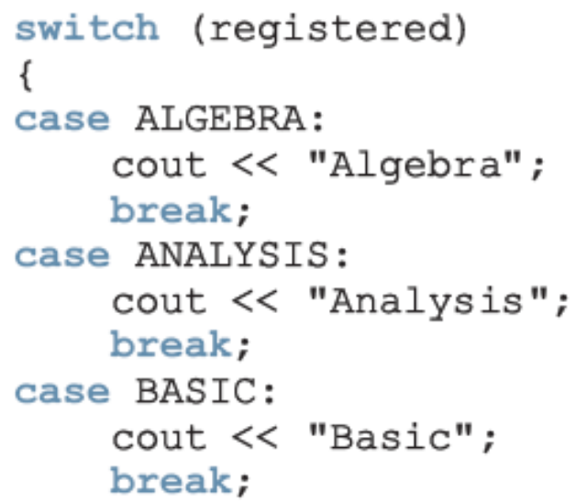
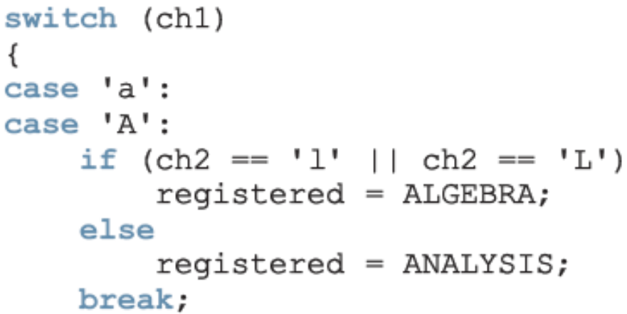
Input /Output of Enumeration Types
I/O are defined only for built-in data types
  Enumeration type cannot be input/output (directly)
C++ Programming: From Problem Analysis to Program Design, Fourth Edition

Slide 13
Functions and Enumeration Types
Enumeration types can be passed as parameters to functions either by value or by reference
A function can return a value of the enumeration type
C++ Programming: From Problem Analysis to Program Design, Fourth Edition

Slide 14
Declaring Variables When Defining the Enumeration Type
You can declare variables of an enumeration type when you define an enumeration type:
C++ Programming: From Problem Analysis to Program Design, Fourth Edition

Slide 15
Anonymous Data Types
Anonymous type : values are directly specified in the declaration, with no type name
Drawbacks:
  Cannot pass/return an anonymous type to/from a function
  Values used in one type can be used in another, but are treated differently:
C++ Programming: From Problem Analysis to Program Design, Fourth Edition

Slide 16
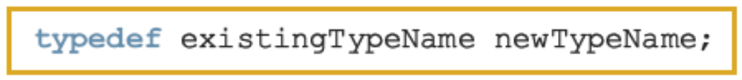
typedef Statement
You can create synonyms or aliases to a data type using the typedef statement
Syntax:
typedef does not create any new data types
  Creates an alias to an existing data type
C++ Programming: From Problem Analysis to Program Design, Fourth Edition

Slide 17
Namespaces
ANSI/ISO standard C++ was officially approved in July 1998
Most of the recent compilers are also compatible with ANSI/ISO standard C++
For the most part, standard C++ and ANSI/ISO standard C++ are the same
  However, ANSI/ISO Standard C++ has some features not available in Standard C++
C++ Programming: From Problem Analysis to Program Design, Fourth Edition

Slide 18
Namespaces (continued)
Global identifiers in a header file used in a program become global in the program
  Syntax error occurs if an identifier in a program has the same name as a global identifier in the header file
Same problem can occur with third-party libraries
  Common solution: third-party vendors begin their global identifiers with _ (underscore)
    Do not begin identifiers in your program with _
C++ Programming: From Problem Analysis to Program Design, Fourth Edition

Slide 19
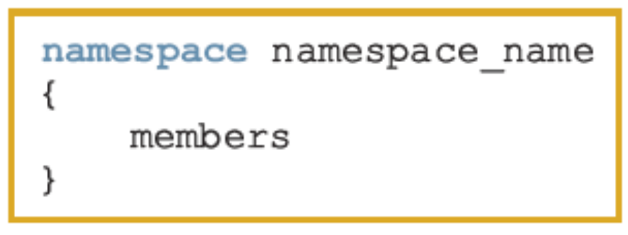
Namespaces (continued)
ANSI/ISO Standard C++ attempts to solve this problem with the namespace mechanism
Syntax:
where a member is usually a variable declaration, a named constant, a function, or another namespace
C++ Programming: From Problem Analysis to Program Design, Fourth Edition

Slide 20
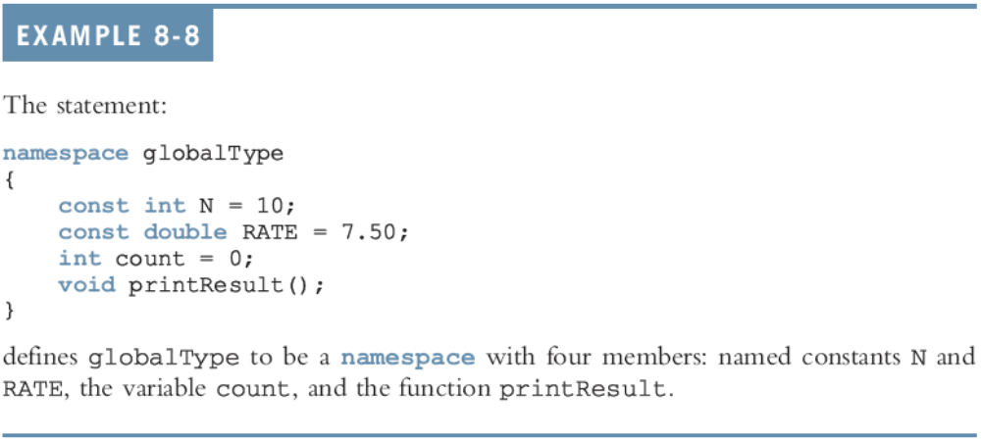
Namespaces (continued)
C++ Programming: From Problem Analysis to Program Design, Fourth Edition

Slide 21
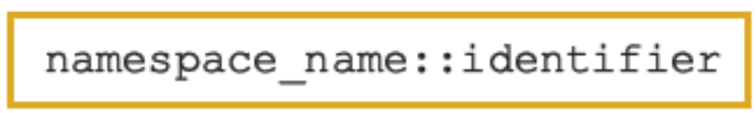

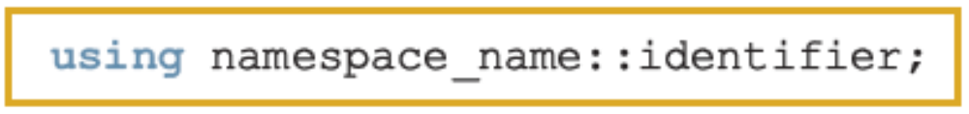
Namespaces (continued)
The scope of a namespace member is local to the namespace
Ways a namespace member can be accessed outside the namespace:
C++ Programming: From Problem Analysis to Program Design, Fourth Edition

Slide 22
Accessing a namespace Member
Examples:
globalType::RATE
globalType::printResult();
After the using statement, it is not necessary to precede the namespace_name:: before the namespace member
  Unless a namespace member and a global identifier or a block identifier have same name
C++ Programming: From Problem Analysis to Program Design, Fourth Edition

Slide 23
string Type
To use the data type string, the program must include the header file string
The statement:
string name = "William Jacob";
declares name to be a string variable and also initializes name to "William Jacob"
  The first character, 'W', is in position 0
  The second character, 'i', is in position 1
  name is capable of storing any size string
C++ Programming: From Problem Analysis to Program Design, Fourth Edition

Slide 24
string Type (continued)
Binary operator + and the array subscript operator [], have been defined for the data type string
  + performs the string concatenation operation
Example:
str1 = "Sunny";
str2 = str1 + " Day";
stores "Sunny Day" into str2
C++ Programming: From Problem Analysis to Program Design, Fourth Edition

Slide 25
Additional string Operations
length
size
find
substr
swap
C++ Programming: From Problem Analysis to Program Design, Fourth Edition

Slide 26
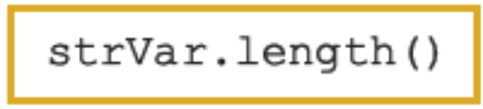
length Function
Returns the number of characters currently in the string
Syntax:
where strVar is variable of the type string
length returns an unsigned integer
The value returned can be stored in an integer variable
C++ Programming: From Problem Analysis to Program Design, Fourth Edition

Slide 27
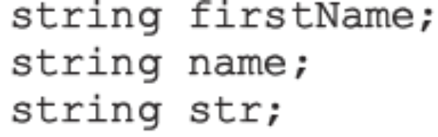
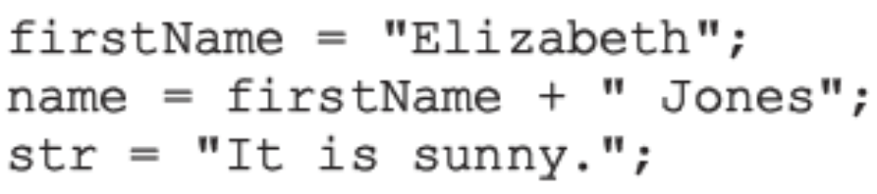
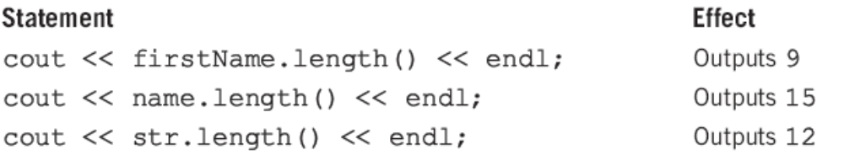
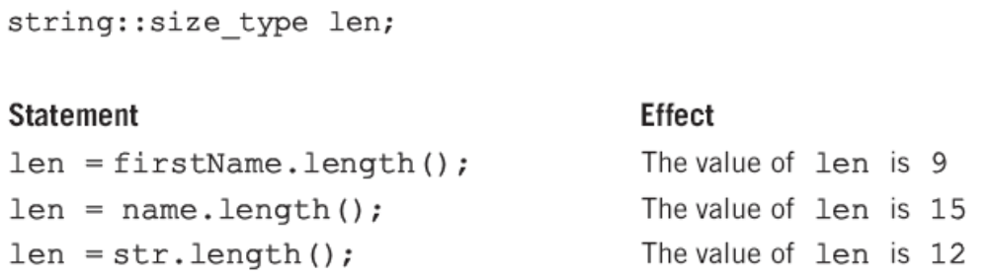

Slide 28

size Function
size is the same as the function length
  Both functions return the same value
Syntax:
  where strVar is variable of the type string
As in the case of the function length, the function size has no arguments
C++ Programming: From Problem Analysis to Program Design, Fourth Edition

Slide 29
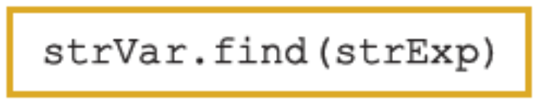
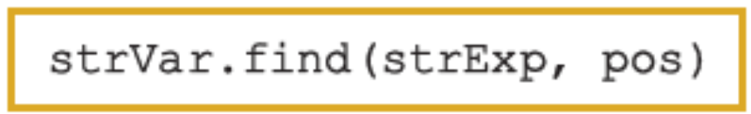
find Function
Searches a string for the first occurrence of a particular substring
Returns an unsigned integer value of type string::size_type
  Or string::npos if unsuccessful
Syntax:
  strExp can be a string or a character
C++ Programming: From Problem Analysis to Program Design, Fourth Edition

Slide 30
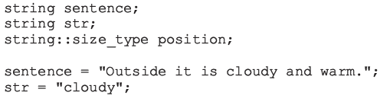
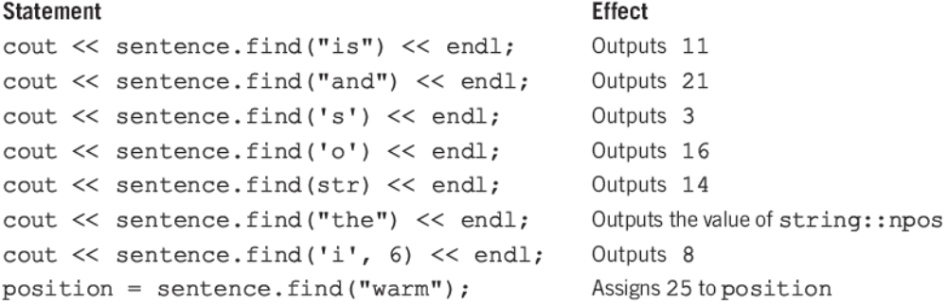
find Function (continued)
C++ Programming: From Problem Analysis to Program Design, Fourth Edition

Slide 31
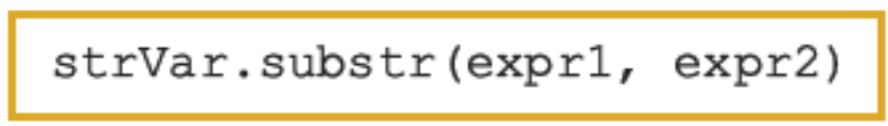
substr Function
Returns a particular substring of a string
Syntax:
  expr1 and expr2 are expressions evaluating to unsigned integers
  expr1 specifies a position within the string (starting position of the substring)
  expr2 specifies the length of the substring to be returned
C++ Programming: From Problem Analysis to Program Design, Fourth Edition

Slide 32
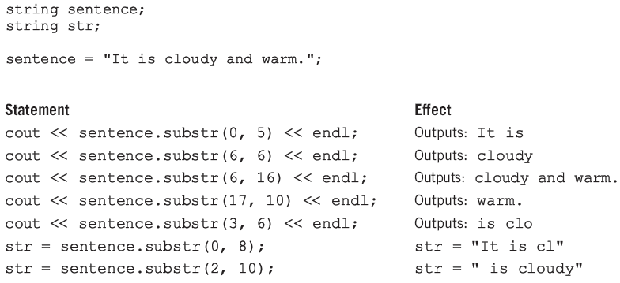
substr Function (continued)
C++ Programming: From Problem Analysis to Program Design, Fourth Edition

Slide 33
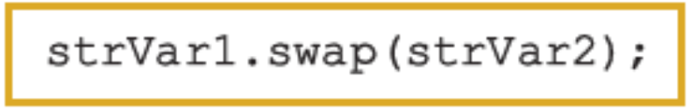
swap Function
Interchanges contents of two string variables
Syntax:
  where strVar1 and strVar2 are string variables
Suppose you have the following statements:
string str1 = "Warm";
string str2 = "Cold";
After str1.swap(str2); executes, the value of str1 is "Cold" and the value of str2 is "War"
C++ Programming: From Problem Analysis to Program Design, Fourth Edition

Slide 34
Programming Example: Pig Latin Strings
Program prompts user to input a string
  Then outputs the string in the pig Latin form
The rules for converting a string into pig Latin form are as follows:
  If the string begins with a vowel, add the string "-way" at the end of the string
    Example: the pig Latin form of "eye" is "eye-way"
C++ Programming: From Problem Analysis to Program Design, Fourth Edition

Slide 35
Programming Example: Pig Latin Strings (continued)
Rules (continued):
  If the string does not begin with a vowel, first add "-" at the end of the string
    Then move the first character of the string to the end of the string until the first character of the string becomes a vowel
    Next, add the string "ay" at the end
    Example: pig Latin form of "There" is "ere-Thay"
C++ Programming: From Problem Analysis to Program Design, Fourth Edition

Slide 36
Programming Example: Pig Latin Strings (continued)
Rules (continued):
  Strings such as "by" contain no vowels
    The letter 'y' can be considered a vowel
    For this program the vowels are a, e, i, o, u, y, A, E, I, O, U, and Y
  Strings such as "1234" contain no vowels
    The pig Latin form of a string that has no vowels in it is the string followed by the string "-way"
    Example: pig Latin form of "1234" is "1234-way"
C++ Programming: From Problem Analysis to Program Design, Fourth Edition

Slide 37
Programming Example: Problem Analysis
If str denotes a string:
  Check the first character, str[0], of str
  If it is a vowel, add "-way" at the end of str
  If it is not a vowel:
    First add "-" at the end of the string
    Remove the first character of str from str and put it at end of str
    Now the second character of str becomes the first character of str
C++ Programming: From Problem Analysis to Program Design, Fourth Edition

Slide 38
Programming Example: Problem Analysis (continued)
If str denotes a string (continued):
  This process is repeated until either
    The first character of str is a vowel
    All characters of str are processed, in which case str does not contain any vowels
C++ Programming: From Problem Analysis to Program Design, Fourth Edition

Slide 39
Programming Example: Algorithm Design
The program contains the following functions:
  isVowel determines if a character is a vowel
  rotate moves first character of str to the end of str
  pigLatinString finds pig Latin form of str
Steps in the algorithm:
  Get str
  Use pigLatinString to find the pig Latin form of str
  Output the pig Latin form of str
C++ Programming: From Problem Analysis to Program Design, Fourth Edition

Slide 40
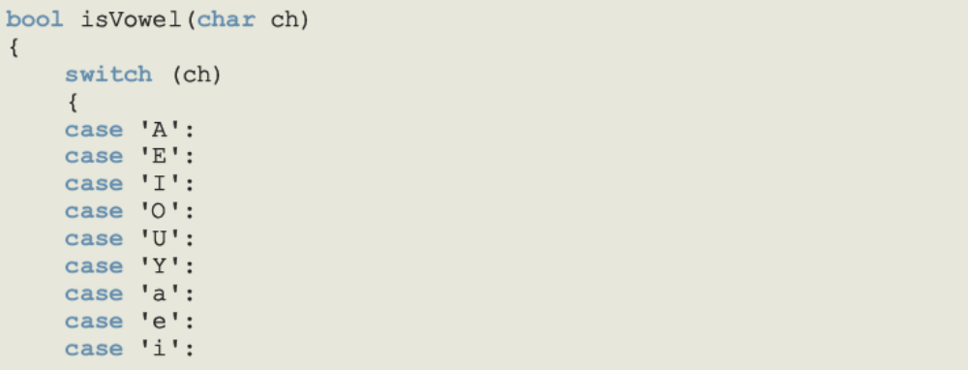
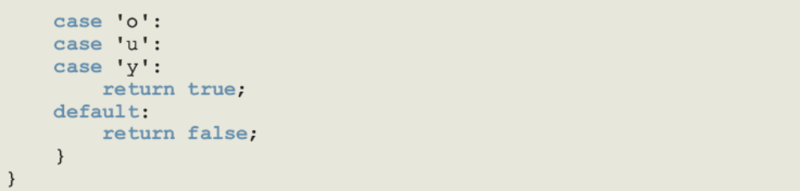
Programming Example: Function isVowel
C++ Programming: From Problem Analysis to Program Design, Fourth Edition

Slide 41
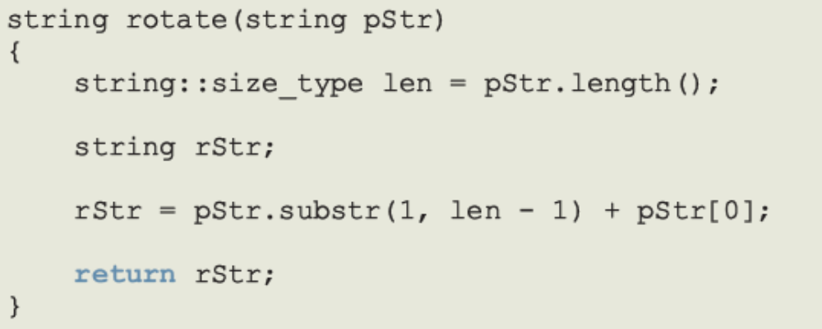
Programming Example: Function rotate
Takes a string as a parameter
Removes the first character of the string
  Places it at end of the string by extracting the substring starting at position 1 until the end of the string, then adding the first character of the string
C++ Programming: From Problem Analysis to Program Design, Fourth Edition

Slide 42
Programming Example: Function pigLatinString
If pStr[0] is a vowel, add "-way" at end
If pStr[0] is not a vowel:
  Move first character of pStr to the end of pStr
  The second character of pStr becomes the first character of pStr
    Now pStr may or may not contain a vowel
  Use a bool variable, foundVowel, which is set to true if pStr contains a vowel and false otherwise
  Initialize foundVowel to false
C++ Programming: From Problem Analysis to Program Design, Fourth Edition

Slide 43
Programming Example: Function pigLatinString (continued)
  If pStr[0] is not a vowel, move str[0] to the end of pStr by calling the function rotate
  Repeat third step until either the first character of pStr becomes a vowel or all characters of pStr have been checked
Convert pStr into the pig Latin form
Return pStr
C++ Programming: From Problem Analysis to Program Design, Fourth Edition

Slide 44
Programming Example: Main Algorithm
Get the string
Call pigLatinString to find the pig Latin form of the string
Output the pig Latin form of the string
C++ Programming: From Problem Analysis to Program Design, Fourth Edition

Slide 45
Summary
Enumeration type: set of ordered values
  Created with reserved word enum creates an enumeration type
No arithmetic operations are allowed on the enumeration type
Relational operators can be used with enum values
Enumeration type values cannot be input or output directly
C++ Programming: From Problem Analysis to Program Design, Fourth Edition

Slide 46
Summary (continued)
Anonymous type: a variable’s values are specified without any type name
Reserved word typedef creates synonyms or aliases to previously defined data types
The namespace mechanism is a feature of ANSI/ISO Standard C++
A namespace member is usually a named constant, variable, function, or another namespace
C++ Programming: From Problem Analysis to Program Design, Fourth Edition

Slide 47
Summary (continued)
Keyword namespace must appear in the using statement
A string is a sequence of zero or more characters
Strings in C++ are enclosed in ""
In C++, [] is the array subscript operator
The function length returns the number of characters currently in the string
C++ Programming: From Problem Analysis to Program Design, Fourth Edition

Slide 48
Summary (continued)
The function size returns the number of characters currently in the string
The function find searches a string to locate the first occurrence of a particular substring
The function substr returns a particular substring of a string
The function swap is used to swap the contents of two string variables
C++ Programming: From Problem Analysis to Program Design, Fourth Edition

